Slide 1
UVa 1614 Hell on the Markets
(NEERC 2008)

Slide 2
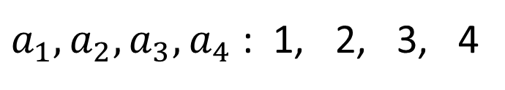
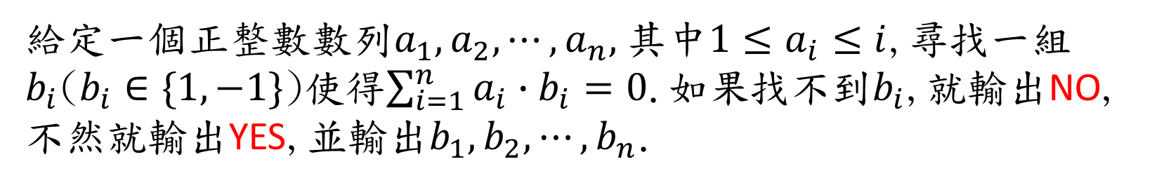
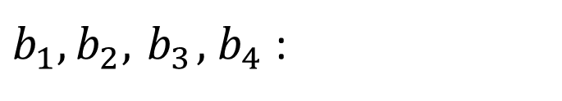
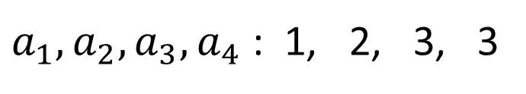
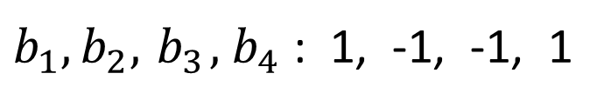
UVa 1614 Hell on the Markets (Time Limit: 3 seconds)
給定一個正整數數列$a_{1},a_{2}, ⋯, a_{n},$其中$1≤a_{i}≤i$,尋找一組$b_{i}$($b_{i}∈\{1, −1\}$)使得$\sum_{i=1}^{n}{a_{i}∙b_{i}=0}$.如果找不到$b_{i}$,就輸出NO, 不然就輸出YES,並輸出$b_{1},b_{2}, ⋯, b_{n}$.
例如:
$a_{1},a_{2},a_{3}, a_{4}$ : 1, 2, 3, 4
YES
$b_{1},b_{2},{ b}_{3}, { b}_{4}$ : 1, -1, -1, 1
$a_{1},a_{2},a_{3}, a_{4}$ : 1, 2, 3, 3
NO
$b_{1},b_{2},{ b}_{3}, { b}_{4}$ :

Slide 3


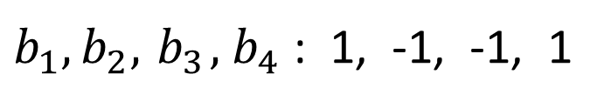
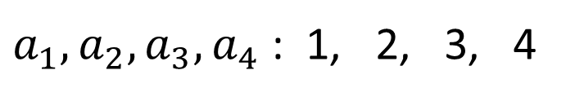

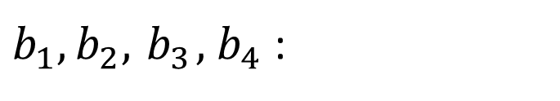
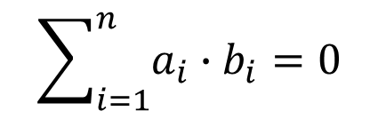
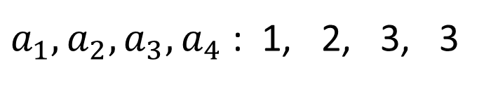
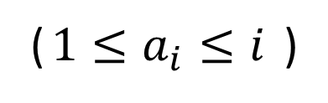
Sample Input
Sample Output
4
1 2 3 3
4
1 2 3 4
n
No
Yes
1 -1 -1 1
$$a_{1},a_{2}, ⋯, a_{n}$$
($1≤a_{i}≤i$ )
${(b}_{1},b_{2},{ b}_{3}, { b}_{4}$)
$a_{1},a_{2},a_{3}, a_{4}$ : 1, 2, 3, 3
$$b_{i}∈\{1, −1\}$$
NO
$b_{1},b_{2},{ b}_{3}, { b}_{4}$ :
$a_{1},a_{2},a_{3}, a_{4}$ : 1, 2, 3, 4
$$\sum_{i=1}^{n}{a_{i}∙b_{i}=0}$$
YES
$b_{1},b_{2},{ b}_{3}, { b}_{4}$ : 1, -1, -1, 1

Slide 4
Solution
Math Theorem
Prefix Sum
Greedy Method
由右至左掃描Prefix Sum陣列
Time Complexity: O(n)

Slide 5
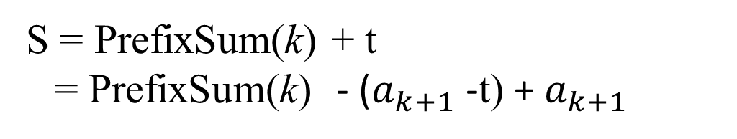
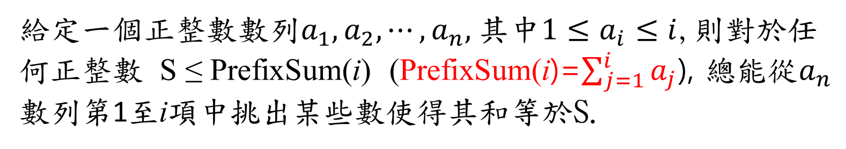
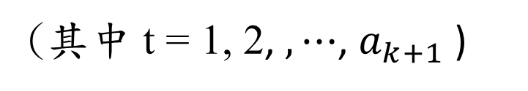
定理:
給定一個正整數數列$a_{1},a_{2}, ⋯, a_{n},$其中$1≤a_{i}≤i$,則對於任何正整數 S ≤ PrefixSum(i) (PrefixSum(i)=$\sum_{j=1}^{i}{a_{j}}$), 總能從$a_{n}$數列第1至i項中挑出某些數使得其和等於S.
證明: (用數學歸納法)
n=1時成立
所以當n=k時也成立
當n=k+1時,對於在PrefixSum(k)+1至PrefixSum(k+1)間的任一整數S
S = PrefixSum(k) + t
= PrefixSum(k) - ($a_{k+1}$ -t) +${ a}_{k+1}$
(其中 t = 1, 2, $, ⋯$, $a_{k+1}$ )
≤
PrefixSum(k)
PrefixSum(k) - ($a_{k+1}$ - t) 這個值等於從數列第1至k項中挑出某些數之和
換言之, S這個值等於從數列第1至k項中挑出某些數之和再加上$a_{k+1}$
因此,當n=k+1時也成立, 得證。

Slide 6
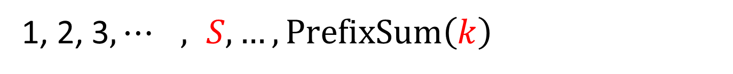
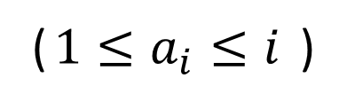
定理:
$$a_{1},a_{2}, ⋯, {a_{k},⋯,a}_{n},$$
($1≤a_{i}≤i$ )
挑出一些數其和 = S
1, 2, 3$, ⋯ , S, {…, {PrefixSum\left(k\right) }_{ }}_{ }$

Slide 7
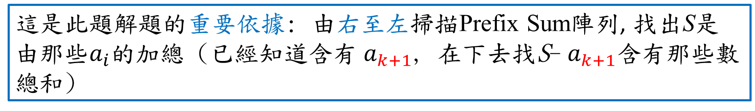
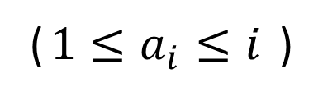
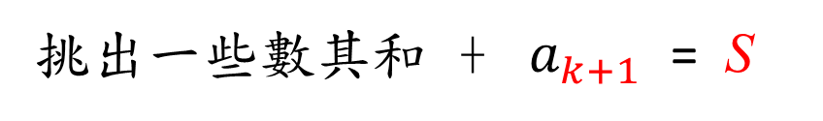
定理:
$$a_{1},a_{2}, ⋯, {a_{k},{ a}_{k+1},⋯,a}_{n},$$
($1≤a_{i}≤i$ )
挑出一些數其和 + ${ a}_{k+1}$ = S
1, 2, 3$, {…, { PrefixSum\left(k\right), …,S, …, PrefixSum(k+1) }_{ }}_{ }$
即 PrefixSum(k) < S ≤ PrefixSum(k+1)
重要條件
這是此題解題的重要依據: 由右至左掃描Prefix Sum陣列, 找出S是由那些$a_{i}$的加總 (已經知道含有${ a}_{k+1}$, 在下去找S-${ a}_{k+1}$含有那些數總和)

Slide 8
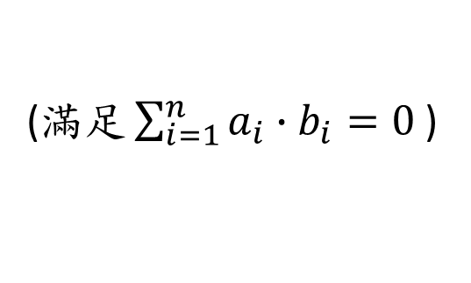
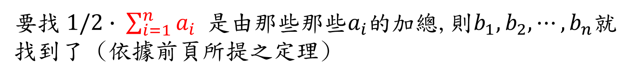
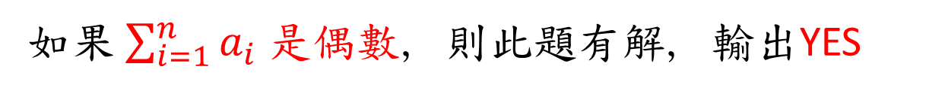
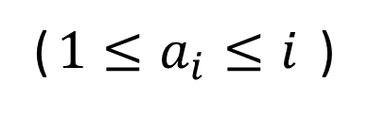

輸入:
$$a_{1},a_{2}, ⋯, {a_{k},{ a}_{k+1},⋯,a}_{n},$$
($1≤a_{i}≤i$ )
如果n=1或是$\sum_{i=1}^{n}{a_{i}}$ 是奇數, 則此題無解, 輸出NO
如果$\sum_{i=1}^{n}{a_{i}}$ 是偶數, 則此題有解, 輸出YES
要找$1/2∙ \sum_{i=1}^{n}{a_{i}}$ 是由那些那些$a_{i}$的加總,則$b_{1},b_{2}, ⋯, b_{n}$就找到了 (依據前頁所提之定理)
$$b_{i}∈\{1, −1\}$$
(滿$足\sum_{i=1}^{n}{a_{i}∙b_{i}=0}$)

Slide 9
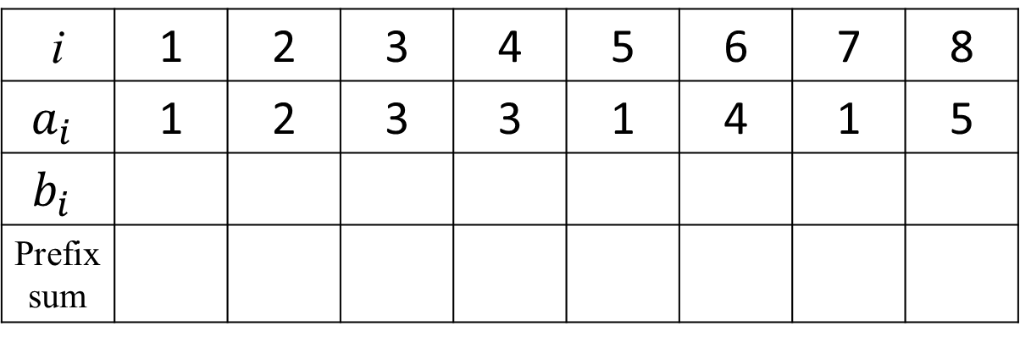
Example 1
i | 1 | 2 | 3 | 4 | 5 | 6 | 7 | 8
$$a_{i}$$ | 1 | 2 | 3 | 3 | 1 | 4 | 1 | 5
$$b_{i}$$
Prefix sum
arr
ans
sum

Slide 10
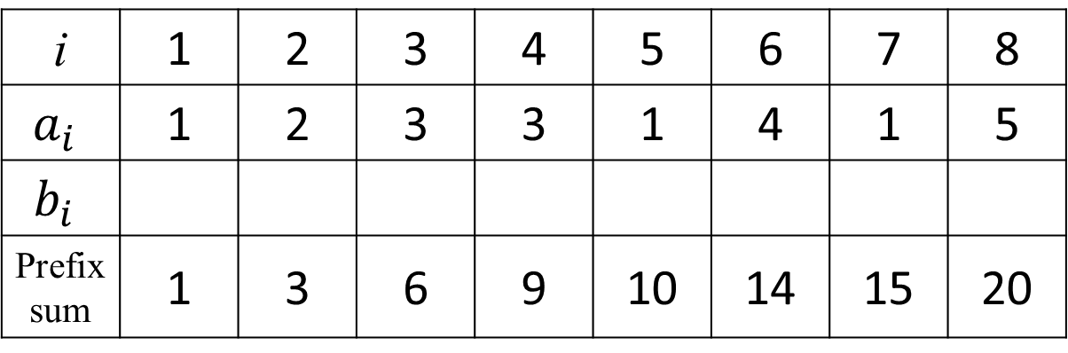
Example 1
i | 1 | 2 | 3 | 4 | 5 | 6 | 7 | 8
$$a_{i}$$ | 1 | 2 | 3 | 3 | 1 | 4 | 1 | 5
$$b_{i}$$
Prefix sum | 1 | 3 | 6 | 9 | 10 | 14 | 15 | 20
Prefix Sum(8) = 20
arr
ans
+
+
+
+
+
+
+
sum

Slide 11
Example 1
i | 1 | 2 | 3 | 4 | 5 | 6 | 7 | 8
$$a_{i}$$ | 1 | 2 | 3 | 3 | 1 | 4 | 1 | 5
$$b_{i}$$
Prefix sum | 1 | 3 | 6 | 9 | 10 | 14 | 15 | 20
Prefix Sum(8) = 20
arr
偶數
ans
tmp=Prefix Sum(8)/2 = 10
sum
YES
要找那些數總和是 tmp (=10)

Slide 12

Example 1
$$∇$$
i | 1 | 2 | 3 | 4 | 5 | 6 | 7 | 8
$$a_{i}$$ | 1 | 2 | 3 | 3 | 1 | 4 | 1 | 5
$$b_{i}$$
Prefix sum | 1 | 3 | 6 | 9 | 10 | 14 | 15 | 20
Prefix Sum(8) = 20
arr
ans
-1
sum
<
≤
tmp=10
?
false

Slide 13

Example 1
$$∇$$
i | 1 | 2 | 3 | 4 | 5 | 6 | 7 | 8
$$a_{i}$$ | 1 | 2 | 3 | 3 | 1 | 4 | 1 | 5
$$b_{i}$$
Prefix sum | 1 | 3 | 6 | 9 | 10 | 14 | 15 | 20
Prefix Sum(8) = 20
arr
ans
-1
-1
sum
<
≤
tmp=10
?
false

Slide 14

Example 1
$$∇$$
i | 1 | 2 | 3 | 4 | 5 | 6 | 7 | 8
$$a_{i}$$ | 1 | 2 | 3 | 3 | 1 | 4 | 1 | 5
$$b_{i}$$
Prefix sum | 1 | 3 | 6 | 9 | 10 | 14 | 15 | 20
Prefix Sum(8) = 20
arr
ans
-1
-1
-1
sum
<
≤
tmp=10
?
false

Slide 15

Example 1
$$∇$$
i | 1 | 2 | 3 | 4 | 5 | 6 | 7 | 8
$$a_{i}$$ | 1 | 2 | 3 | 3 | 1 | 4 | 1 | 5
$$b_{i}$$
Prefix sum | 1 | 3 | 6 | 9 | 10 | 14 | 15 | 20
Prefix Sum(8) = 20
arr
ans
1
-1
-1
-1
sum
<
≤
tmp=10
?
true
tmp=tmp-a[4+1]=10-1=9

Slide 16

Example 1
$$∇$$
i | 1 | 2 | 3 | 4 | 5 | 6 | 7 | 8
$$a_{i}$$ | 1 | 2 | 3 | 3 | 1 | 4 | 1 | 5
$$b_{i}$$
Prefix sum | 1 | 3 | 6 | 9 | 10 | 14 | 15 | 20
Prefix Sum(8) = 20
arr
ans
1
1
-1
-1
-1
sum
<
≤
tmp=9
?
true
tmp=tmp-a[3+1]=9-3=6

Slide 17

Example 1
$$∇$$
i | 1 | 2 | 3 | 4 | 5 | 6 | 7 | 8
$$a_{i}$$ | 1 | 2 | 3 | 3 | 1 | 4 | 1 | 5
$$b_{i}$$
Prefix sum | 1 | 3 | 6 | 9 | 10 | 14 | 15 | 20
Prefix Sum(8) = 20
arr
ans
1
1
1
-1
-1
-1
sum
<
≤
tmp=6
?
true
tmp=tmp-a[2+1]=6-3=3

Slide 18

Example 1
$$∇$$
i | 1 | 2 | 3 | 4 | 5 | 6 | 7 | 8
$$a_{i}$$ | 1 | 2 | 3 | 3 | 1 | 4 | 1 | 5
$$b_{i}$$
Prefix sum | 1 | 3 | 6 | 9 | 10 | 14 | 15 | 20
Prefix Sum(8) = 20
arr
ans
1
1
1
1
-1
-1
-1
sum
<
≤
tmp=3
?
true
tmp=tmp-a[1+1]=3-2=1

Slide 19

Example 1
$$∇$$
i | 1 | 2 | 3 | 4 | 5 | 6 | 7 | 8
$$a_{i}$$ | 1 | 2 | 3 | 3 | 1 | 4 | 1 | 5
$$b_{i}$$
Prefix sum | 1 | 3 | 6 | 9 | 10 | 14 | 15 | 20
Prefix Sum(8) = 20
arr
ans
1
1
1
1
1
-1
-1
-1
sum
tmp=1
!= 0 ?
true
b[1]=1

Slide 20
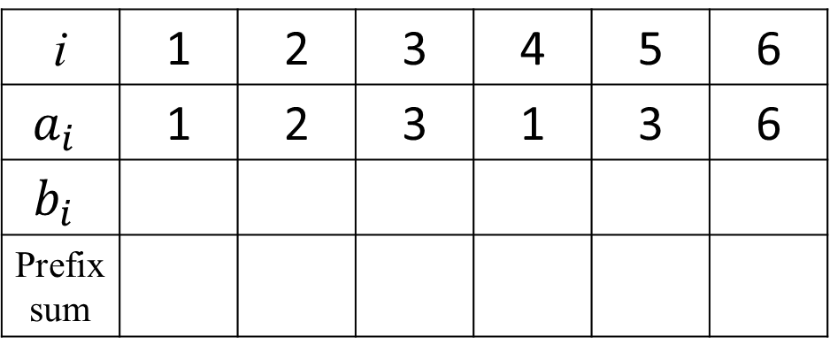
Example 2
i | 1 | 2 | 3 | 4 | 5 | 6
$$a_{i}$$ | 1 | 2 | 3 | 1 | 3 | 6
$$b_{i}$$
Prefix sum
arr
ans
sum

Slide 21
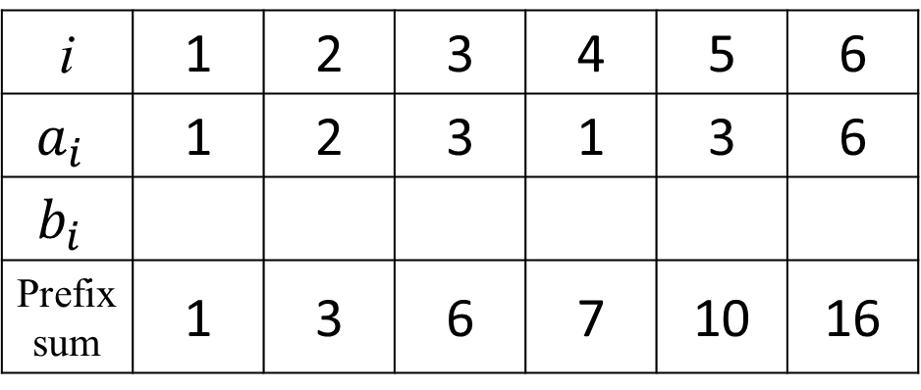
Example 2
i | 1 | 2 | 3 | 4 | 5 | 6
$$a_{i}$$ | 1 | 2 | 3 | 1 | 3 | 6
$$b_{i}$$
Prefix sum | 1 | 3 | 6 | 7 | 10 | 16
Prefix Sum(6) = 16
arr
ans
+
+
+
+
+
sum

Slide 22
Example 2
i | 1 | 2 | 3 | 4 | 5 | 6
$$a_{i}$$ | 1 | 2 | 3 | 1 | 3 | 6
$$b_{i}$$
Prefix sum | 1 | 3 | 6 | 7 | 10 | 16
Prefix Sum(6) = 16
arr
偶數
ans
tmp=Prefix Sum(6)/2 = 8
sum
YES
要找那些數總和是 tmp (=8)

Slide 23
Example 2
$$∇$$
i | 1 | 2 | 3 | 4 | 5 | 6
$$a_{i}$$ | 1 | 2 | 3 | 1 | 3 | 6
$$b_{i}$$
Prefix sum | 1 | 3 | 6 | 7 | 10 | 16
Prefix Sum(6) = 16
arr
ans
-1
sum
<
≤
tmp=8
?
false

Slide 24
Example 2
$$∇$$
i | 1 | 2 | 3 | 4 | 5 | 6
$$a_{i}$$ | 1 | 2 | 3 | 1 | 3 | 6
$$b_{i}$$
Prefix sum | 1 | 3 | 6 | 7 | 10 | 16
Prefix Sum(6) = 16
arr
ans
1
-1
sum
<
≤
tmp=8
?
true
tmp=tmp-a[4+1]=8-3=5

Slide 25
Example 2
$$∇$$
i | 1 | 2 | 3 | 4 | 5 | 6
$$a_{i}$$ | 1 | 2 | 3 | 1 | 3 | 6
$$b_{i}$$
Prefix sum | 1 | 3 | 6 | 7 | 10 | 16
Prefix Sum(6) = 16
arr
ans
-1
1
-1
sum
<
≤
tmp=5
?
false

Slide 26
Example 2
$$∇$$
i | 1 | 2 | 3 | 4 | 5 | 6
$$a_{i}$$ | 1 | 2 | 3 | 1 | 3 | 6
$$b_{i}$$
Prefix sum | 1 | 3 | 6 | 7 | 10 | 16
Prefix Sum(6) = 16
arr
ans
1
-1
1
-1
sum
<
≤
tmp=5
?
true
tmp=tmp-a[2+1]=5-3=2

Slide 27
Example 2
$$∇$$
i | 1 | 2 | 3 | 4 | 5 | 6
$$a_{i}$$ | 1 | 2 | 3 | 1 | 3 | 6
$$b_{i}$$
Prefix sum | 1 | 3 | 6 | 7 | 10 | 16
Prefix Sum(6) = 16
arr
ans
1
1
-1
1
-1
sum
<
≤
tmp=2
?
true
tmp=tmp-a[1+1]=2-2=0

Slide 28
Example 2
$$∇$$
i | 1 | 2 | 3 | 4 | 5 | 6
$$a_{i}$$ | 1 | 2 | 3 | 1 | 3 | 6
$$b_{i}$$
Prefix sum | 1 | 3 | 6 | 7 | 10 | 16
Prefix Sum(6) = 16
arr
ans
-1
1
1
-1
1
-1
sum
tmp=0
!= 0 ?
false
b[1]=-1

Slide 29
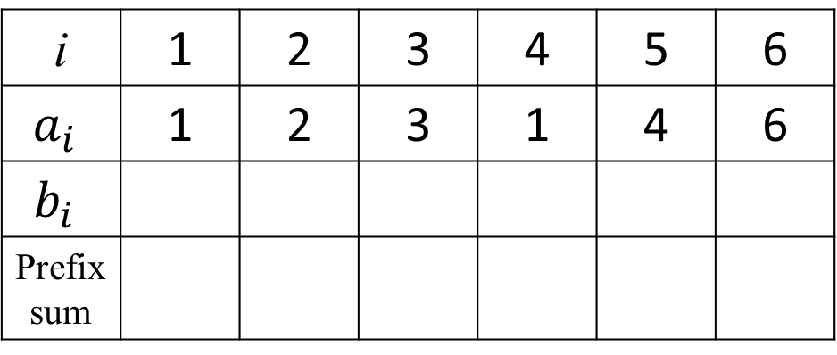
Example 3
i | 1 | 2 | 3 | 4 | 5 | 6
$$a_{i}$$ | 1 | 2 | 3 | 1 | 4 | 6
$$b_{i}$$
Prefix sum
arr
ans
sum

Slide 30
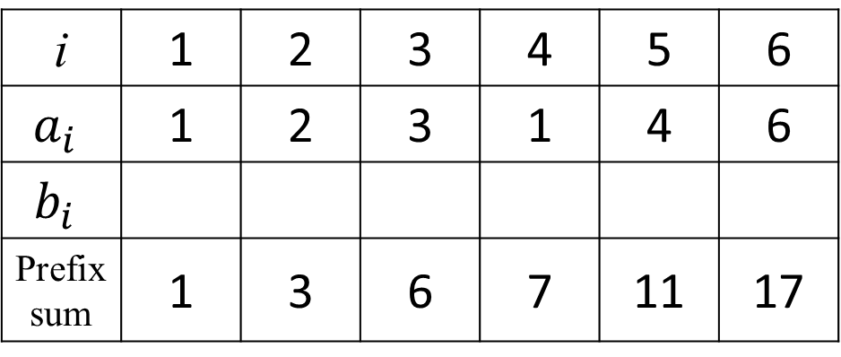
Example 3
i | 1 | 2 | 3 | 4 | 5 | 6
$$a_{i}$$ | 1 | 2 | 3 | 1 | 4 | 6
$$b_{i}$$
Prefix sum | 1 | 3 | 6 | 7 | 11 | 17
Prefix Sum(6) = 17
arr
ans
+
+
+
+
+
sum

Slide 31
Example 3
i | 1 | 2 | 3 | 4 | 5 | 6
$$a_{i}$$ | 1 | 2 | 3 | 1 | 4 | 6
$$b_{i}$$
Prefix sum | 1 | 3 | 6 | 7 | 11 | 17
Prefix Sum(6) = 17
arr
奇數
ans
NO
sum

Slide 32
Uva 1614 Code (1/3)
#include <iostream>
#include <cstring>
#include <cstdio>
#define int long long
using namespace std;
const int maxm=100100;
int n,arr[maxm],sum[maxm],tmp; // 陣列arr: 數列a, 陣列sum: prefix sum
bool ans[maxm]; // 陣列ans: 存b[i]是1或-1; true: b[i]=1, false: b[i]:-1

Slide 33
signed main() {
ios_base::sync_with_stdio(0);
freopen("1614.in","r",stdin);
freopen("1614.out","w",stdout);
while(cin>>n) {
for(int i=1;i<=n;++i) { cin>>arr[i]; sum[i]=arr[i]+sum[i-1]; } // 計算prefix sum
if (sum[n]&1||n==1) { cout<<“No\n”; continue; } //數列a總和是奇數或n=1,無解
tmp=sum[n]>>1; // 起始時tmp存數列a總和的一半
for(int i=n-1;i;--i) // 線性掃描Prefix sum由右至左找那些a[i]總和是tmp
if (sum[i]<tmp && tmp<=sum[i+1]) {
tmp -= arr[i+1]; // arr[i+1]是其中一個數, 更新tmp繼續往下找
ans[i+1]=true; // 記錄 arr[i+1]對應之b[i+1] (以ans[i+1]表示)為1
}
else
ans[i+1]=false; // 記錄 arr[i+1]對應之b[i+1] (以ans[i+1]表示)-1
if (tmp) ans[1]=true; else ans[1]=false; // 決定arr[1]是否是其中一個數
Uva 1614 Code (2/3)

Slide 34
Uva 1614 Code (3/3)
cout<<“Yes\n”; // 輸出YES結果, 各個b[i]值
for(int i=1;i<n;++i)
cout<<(ans[i]?1:-1)<<' ‘;
cout<<(ans[n]?1:-1)<<"\n";
}
return 0;
}

